Slide 1
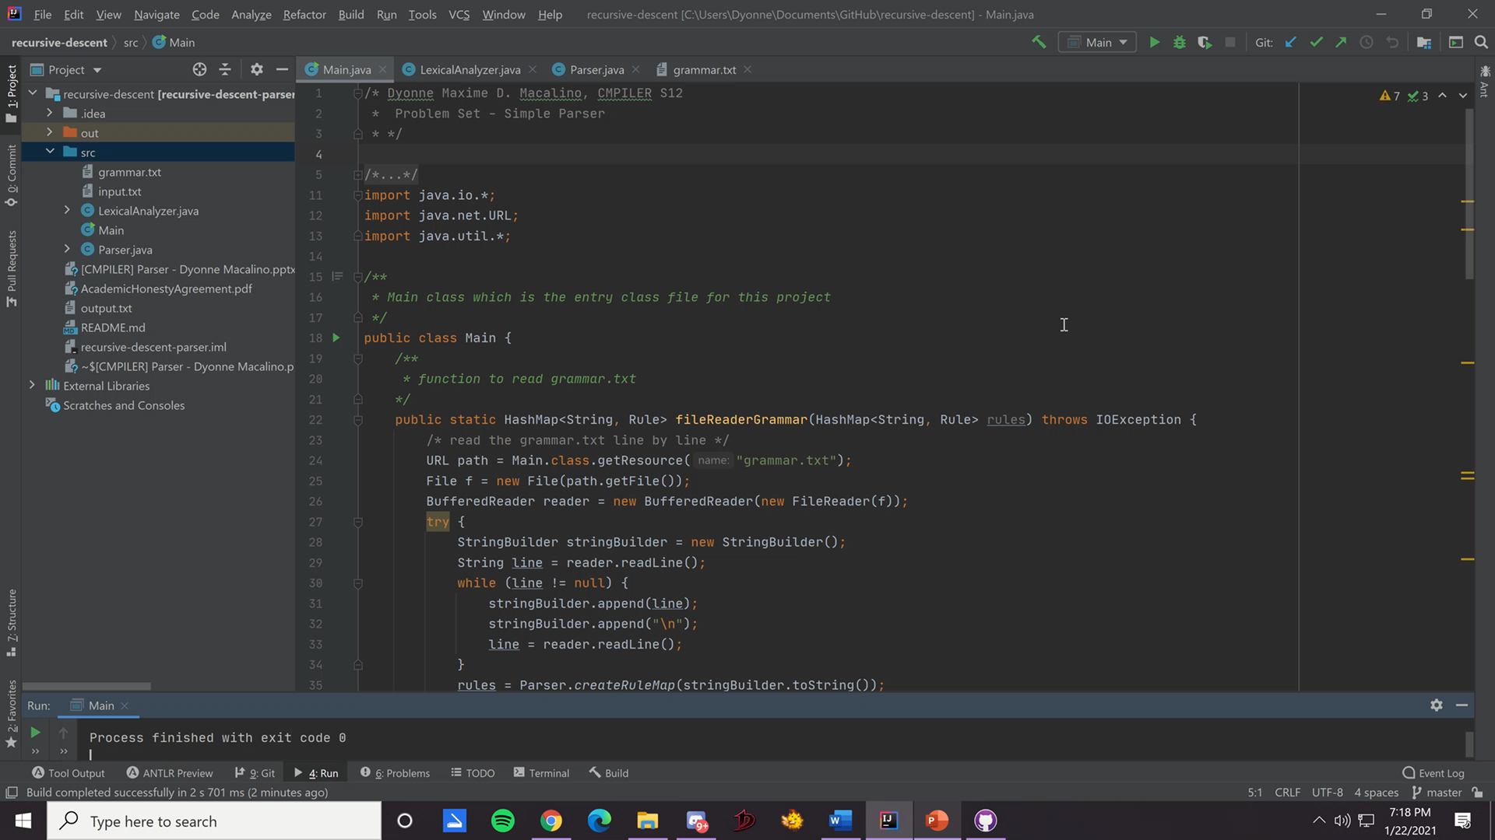
Problem Set: Creating a Simple Parser
Submitted by: Dyonne Maxime D. Macalino | CMPILER S12

Slide 2
Syntax Analysis
Discussion of different implementations

Slide 3
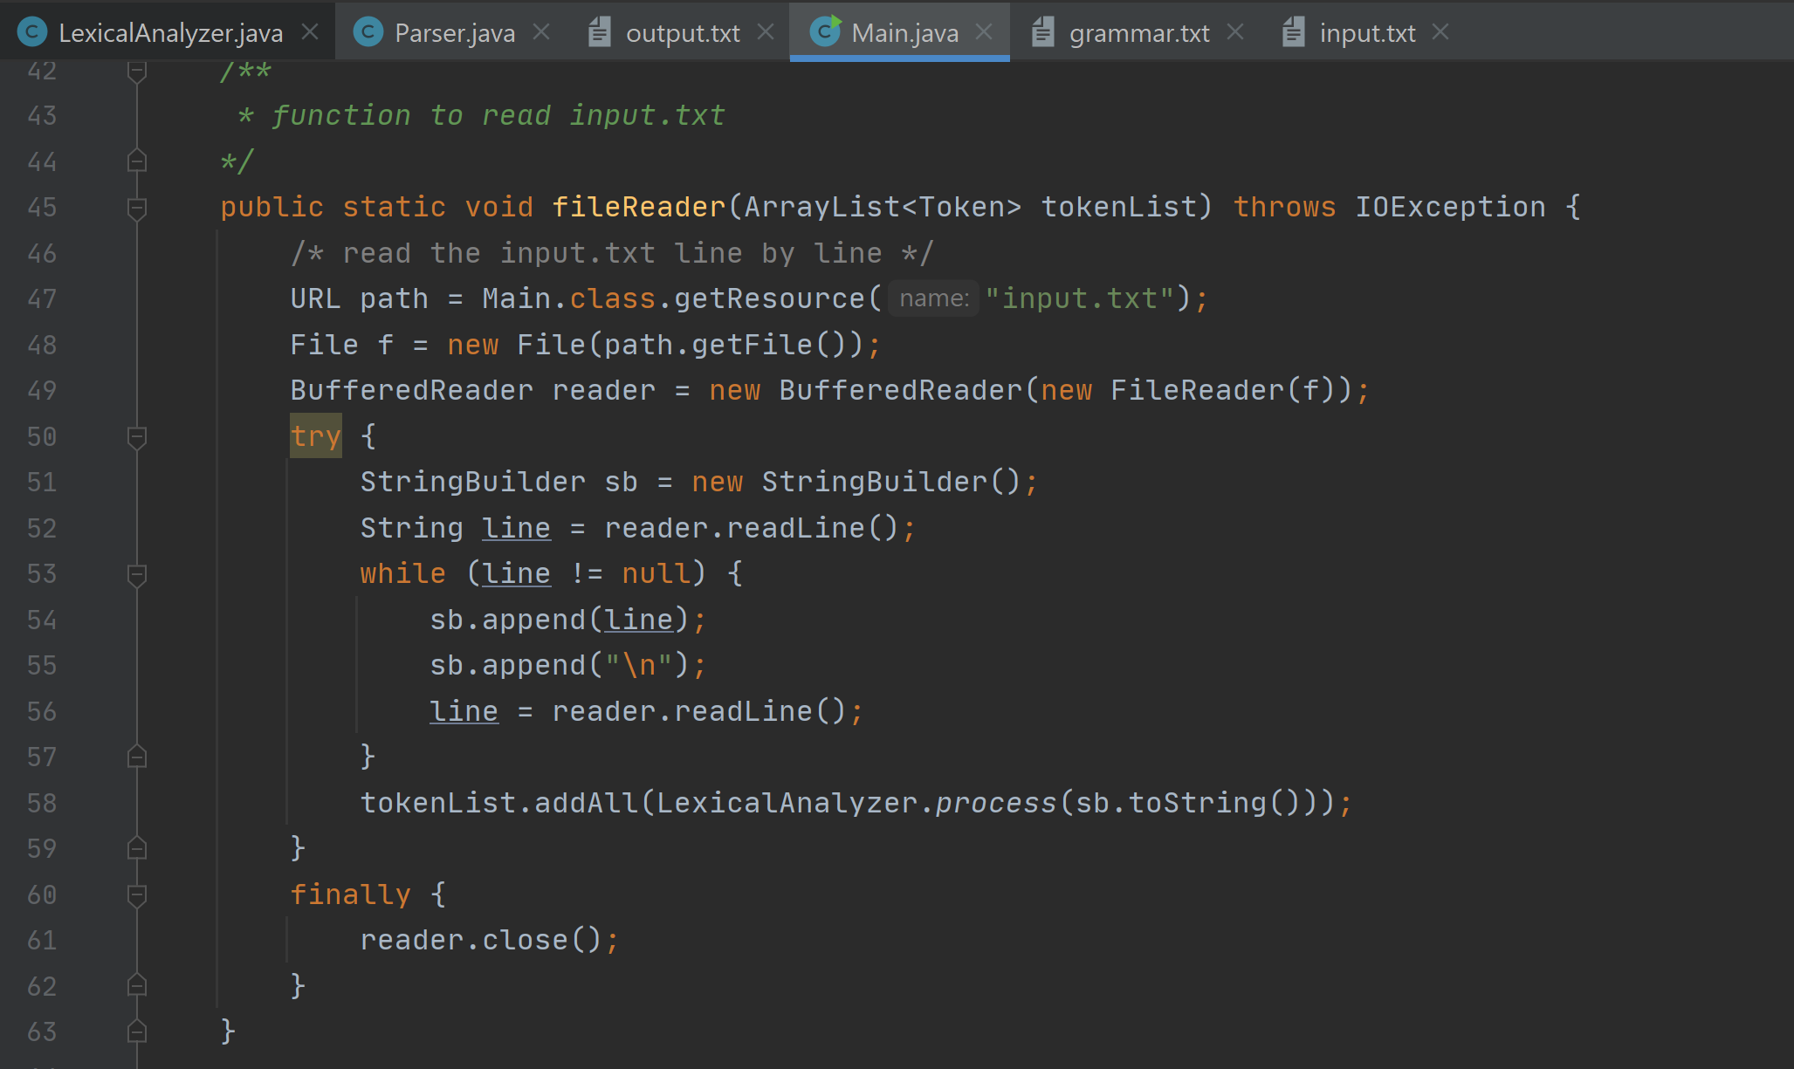
Reading Text Input and Create Tokens
The text input is read through a fileReader function called in main that initially takes in an empty ArrayList<Token> tokenList.
The function makes use of the BufferedReader class to read the “input.txt” provided, and after reading line by line, creates token classes for each number, symbol, or invalid token (these are the terminal symbols), and adds it to the tokenList.
The tokenList is then passed to the parser to proceed with error recovery.

Slide 4
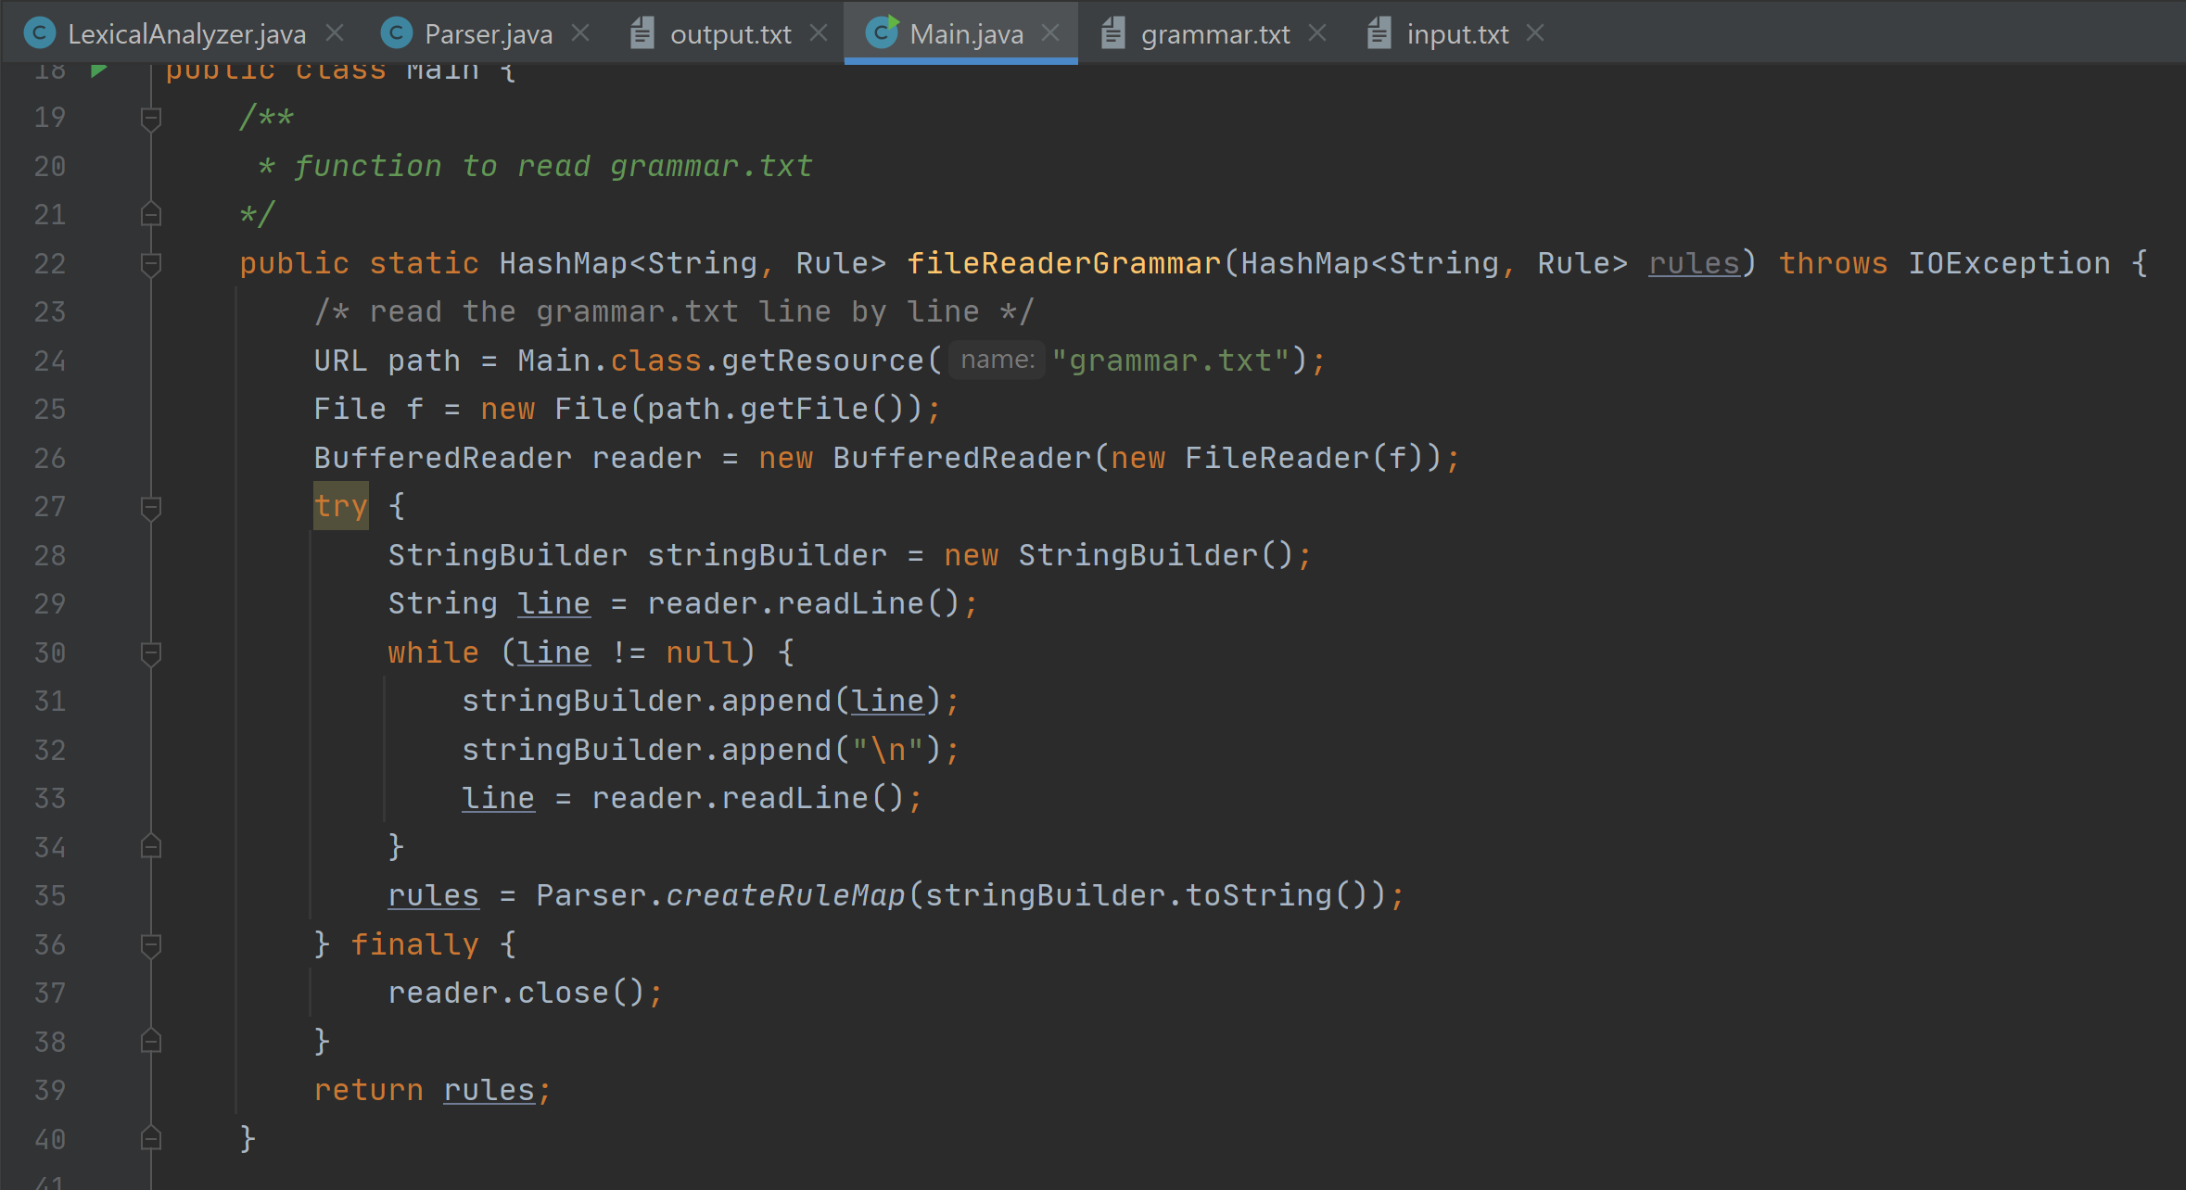
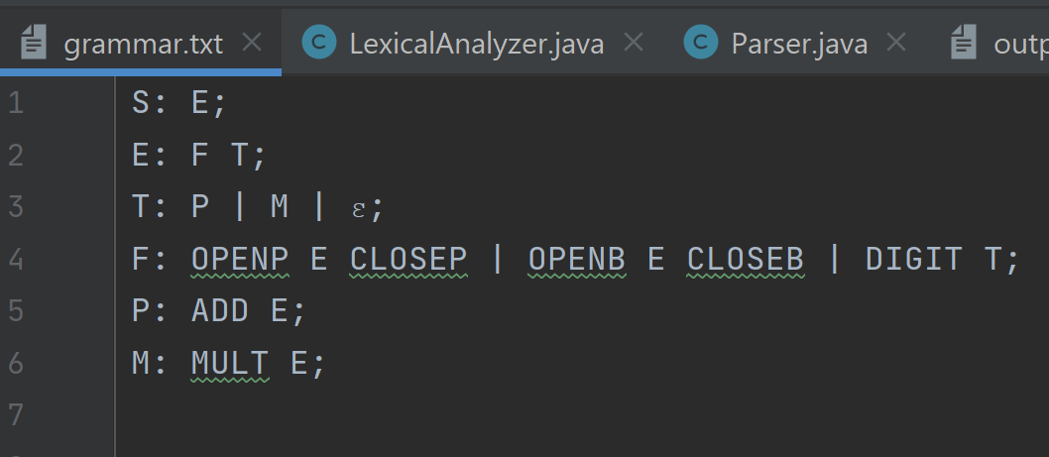
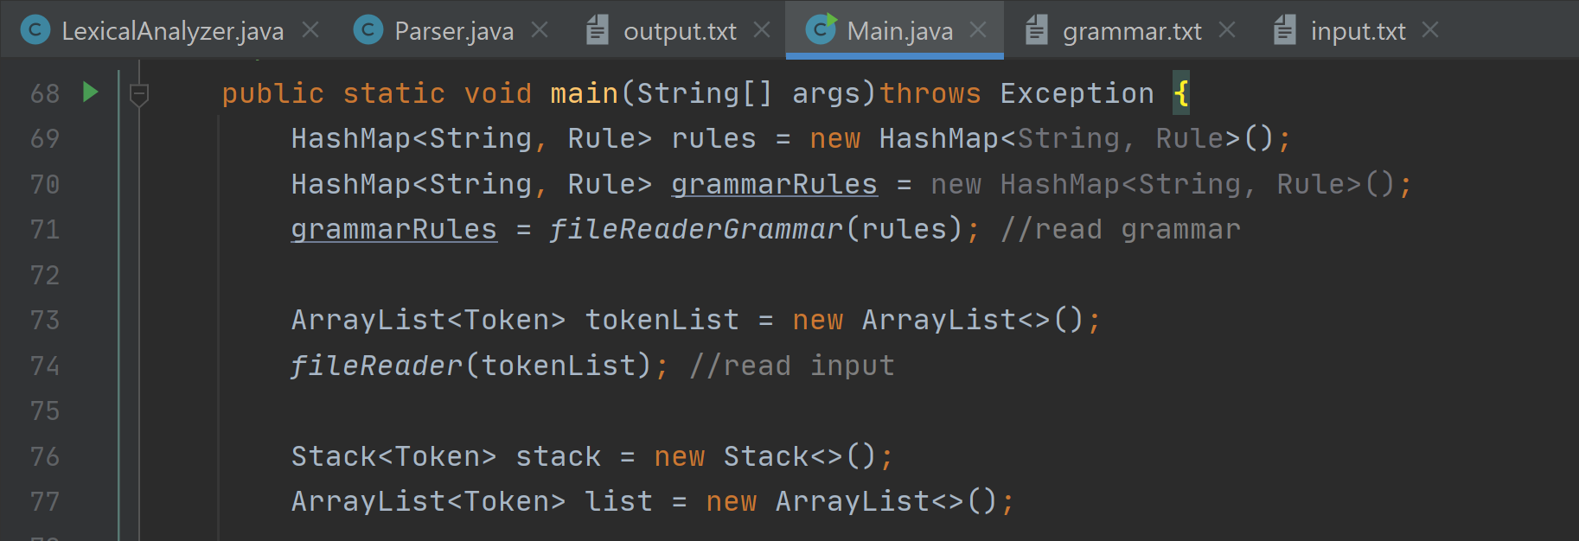
Reading Grammar File and Create Grammar Rules
The grammar rules are made through a fileReaderGrammar function called in main that reads the “grammar.txt” file containing the rules for LHS and RHS, that are separated by ":" respectively. RHS have a list of Strings which are non-terminals separated by the "|" symbol.
The function makes use of the BufferedReader class to read the “grammar.txt” provided, and after reading line by line, creates the grammar rules which will be saved in a HashMap as the LHS

Slide 5
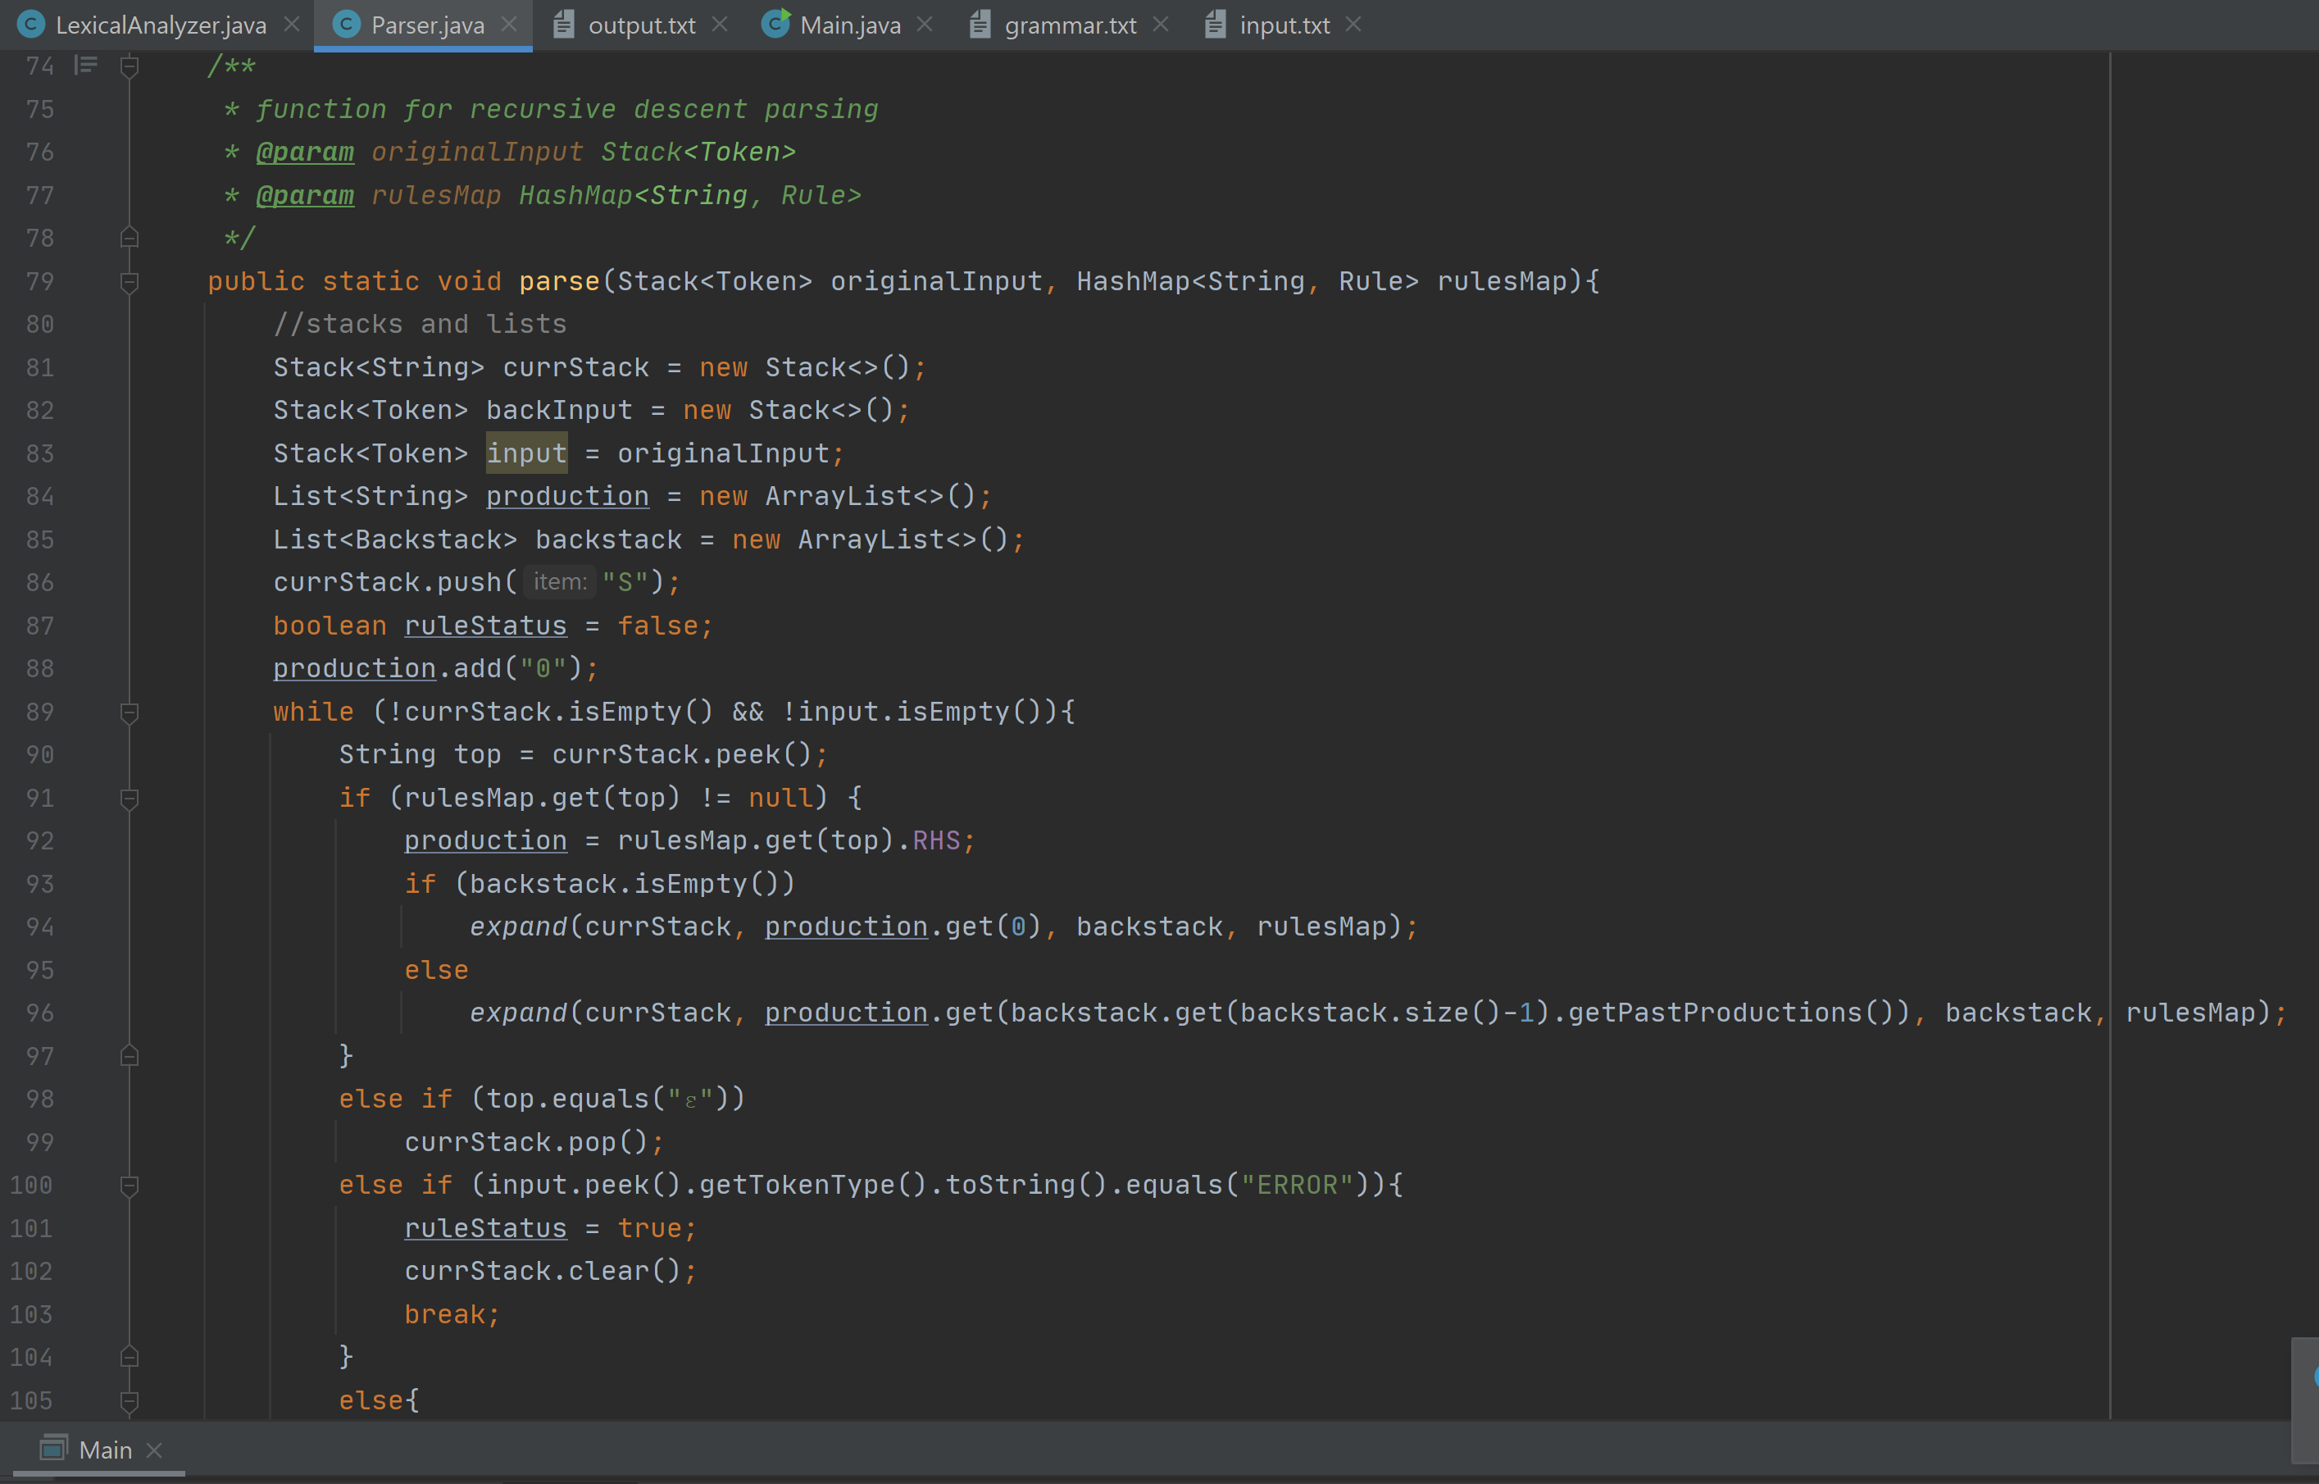
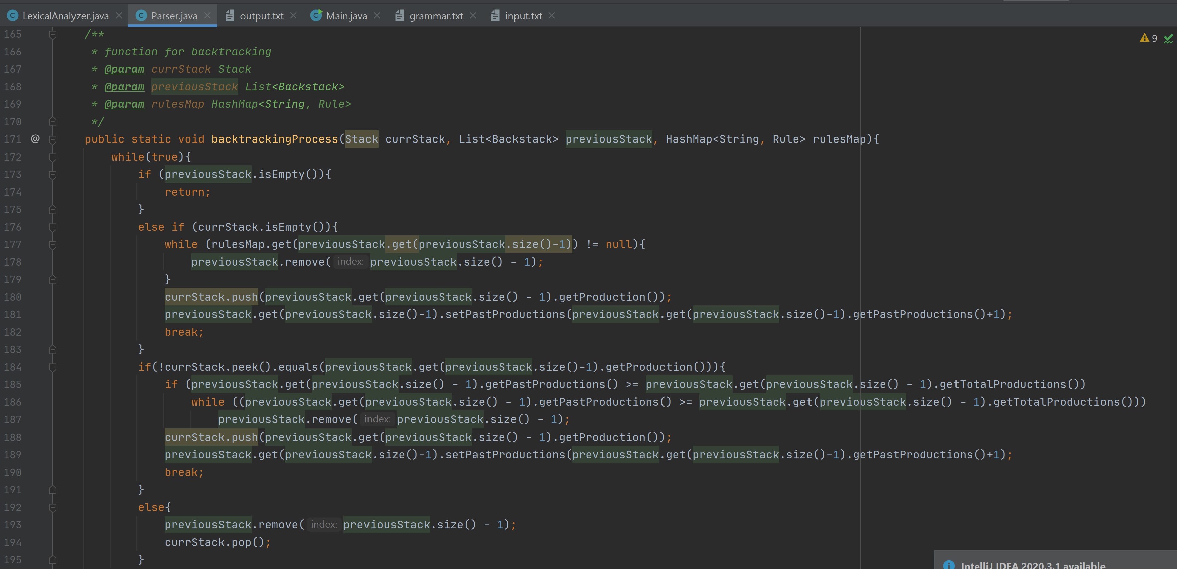
Implementation of Recursive Descent Parser
Recursive-descent parsers have a backtracking process, which allows the parser to go back and test another production of a non-terminal symbol found in the stack.
In the Parser.java class, there is a function called parse() which saves the input stack and production stack separately, and if the input does not match a production, the past production will be used as the current stack and there is a counter to indicate should the program proceed to the next rule.
Once the counter reaches the last production, the parent non-terminal is read until a match is found or until the start state is reached again.

Slide 6
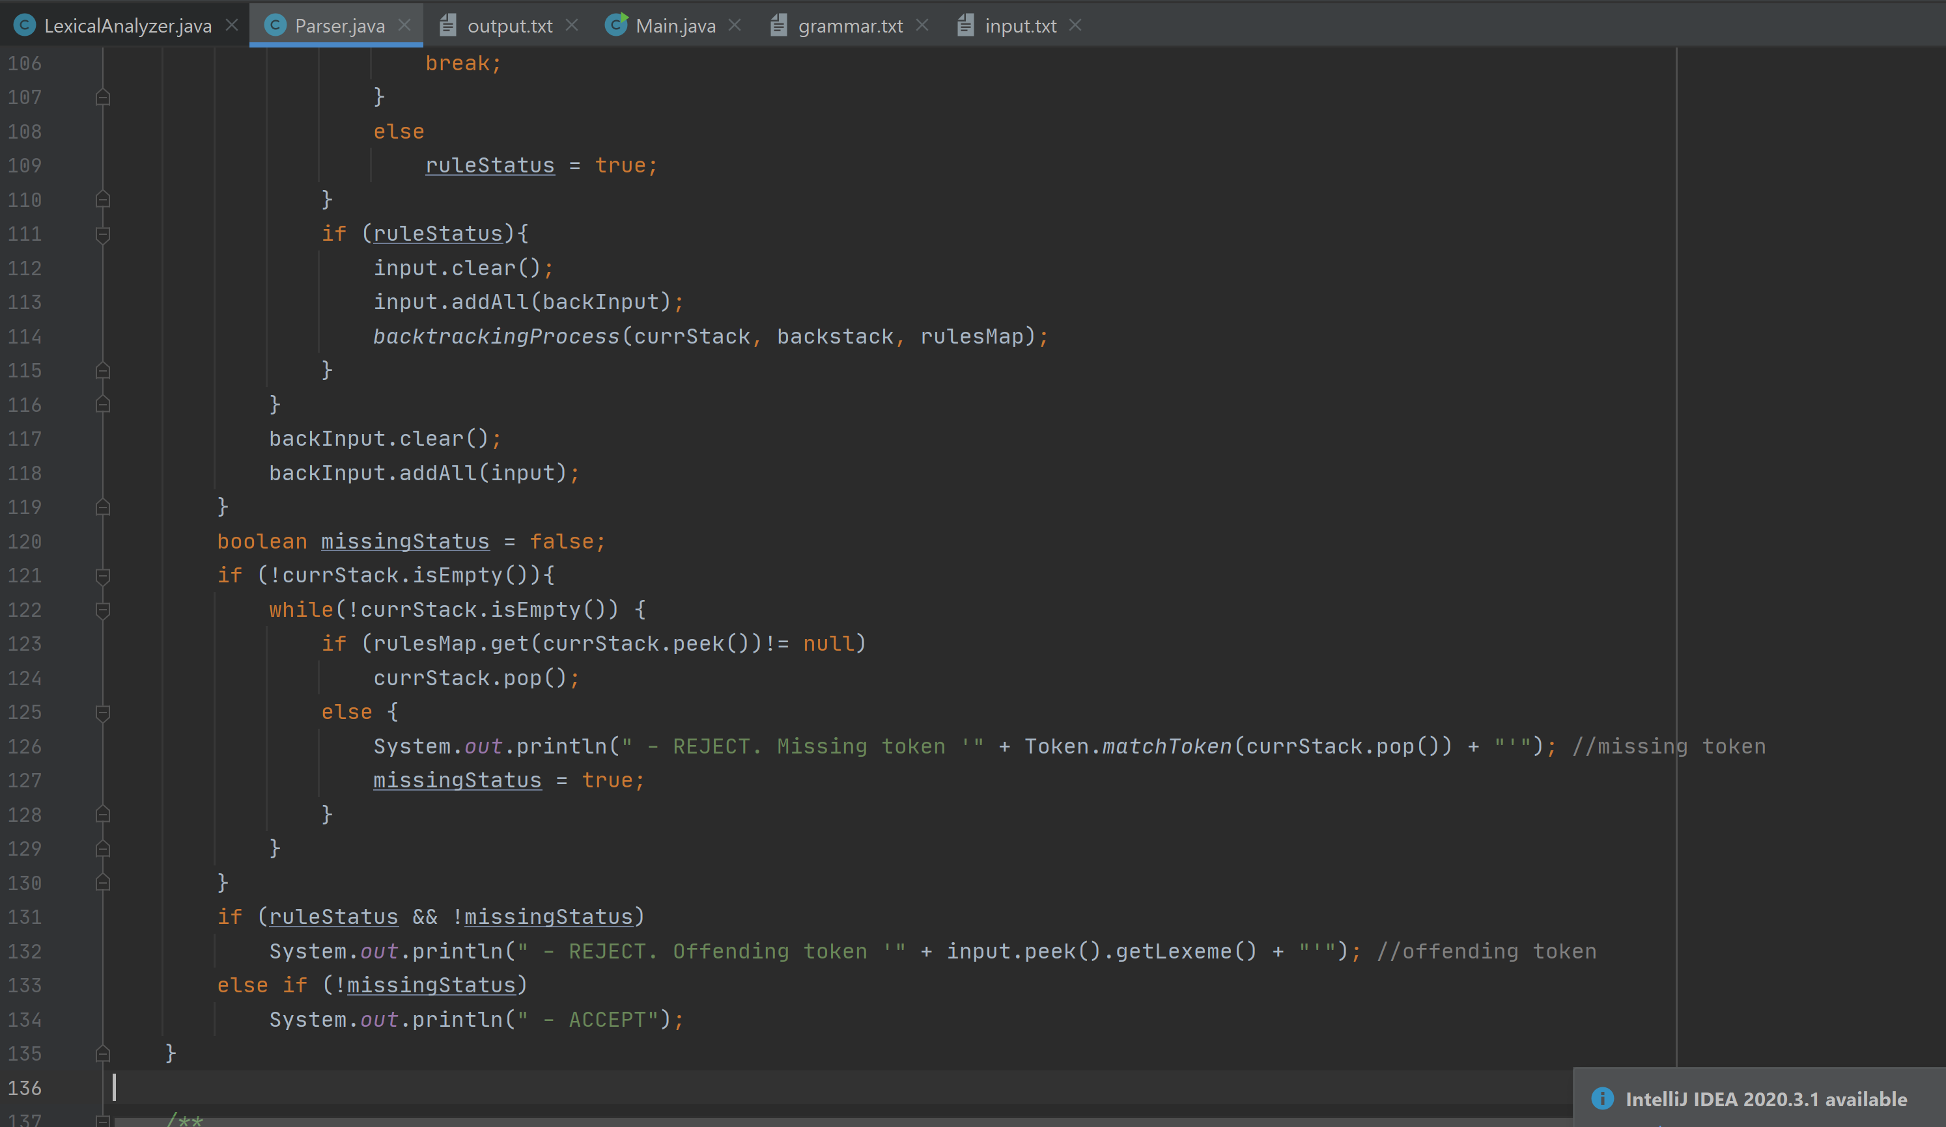
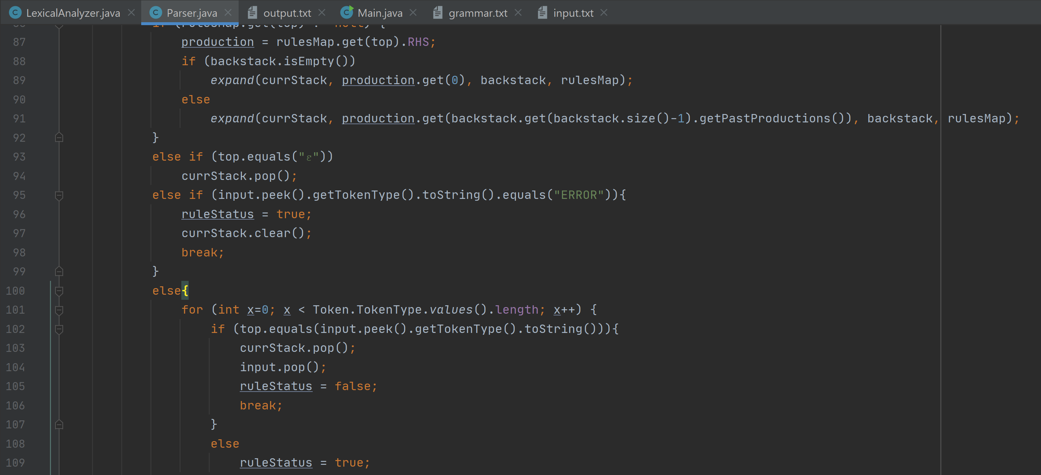
Recover from parsing errors
Parsing errors are handled by using the "panic mode" recovery which means that invalid tokens detected by the parser are printed and appended to the output.txt.
ruleStatus in the parse() function is updated as needed in the backtracking process by the recursive descent parser
The offending or missing token is printed out beside the "REJECT" status

Slide 7

Thank
you!
Github repository:
https://github.com/dyonne-mio/recursive-descent

